Slide 1
INVESTMENT CASE STUDY SUBMISSION
Group Name:
Pradnya Garde
Prachi Agarwal
Pranesh Krishnamurthy
Prashanth Chandra Shekar

Slide 2
Abstract
Strategy: Invest where large investments are made.
Objective of analysis: Determine markets where large volumes of investments are being made
Constraints:
Capital: Available capital amount was between 5 and 15 million USD.
Country: Countries where English is an official language
Results:
Best investment choices are companies which:
Operate in the cutting edge technology space
Have had seed / angel funding and are looking for venture capital
Are from the USA

Slide 3
Problem solving methodology
Data Preparation
Data Analysis
Reporting
Cleaning
Processing
Reshaping
Exploration
Visualization
Inference
Presentation
Methodology taken from http://www.gastonsanchez.com/

Slide 4
Nature of data
Goal of analysis: Identify the most heavily invested
Sectors
Countries
Funding type
The data was distributed across three files namely:
A companies file: with 66380 rows and 10 columns
Contained information about companies
A rounds file with 114949 rows and 6 columns
Contained information about investment companies received
A mapping file with
Contained information about various sectors in which companies operated

Slide 5
Funding Type
Four major types considered:
Venture
Seed
Angle
Private Equity
Captial Constraint: 5 to 15 Million USD
Best funding type based on constraint: Venture

Slide 6
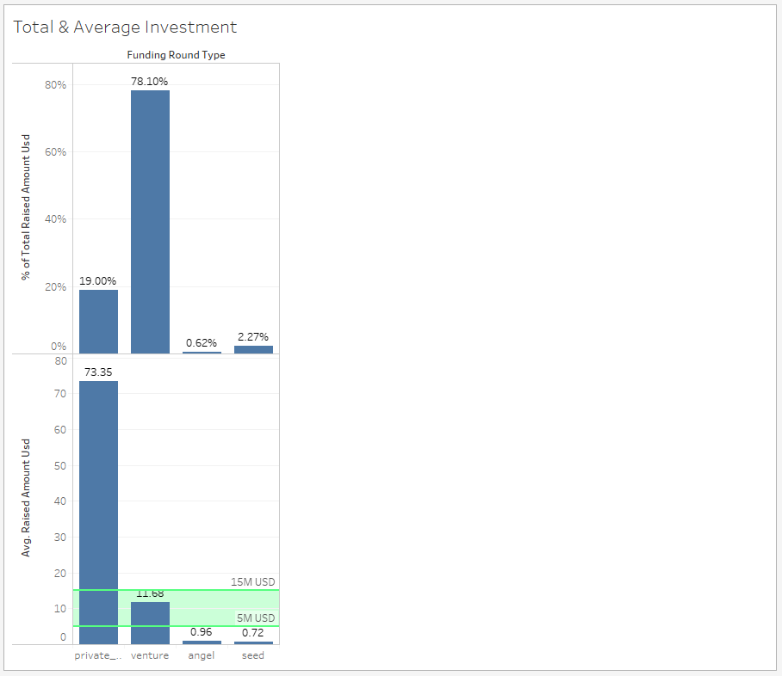

Slide 7
Countries and Sectors
Best coutries to invest in:
United States of America
Best sectors: IT, computer science, etc; Cleantech; Semiconductors; Finance
Great Britain:
Best sectors: IT, computer science, etc; Cleantech; Semiconductors; Finance
India:
Best sectors: IT, computer science, etc; Analytics and Finance; News and messaging

Slide 8
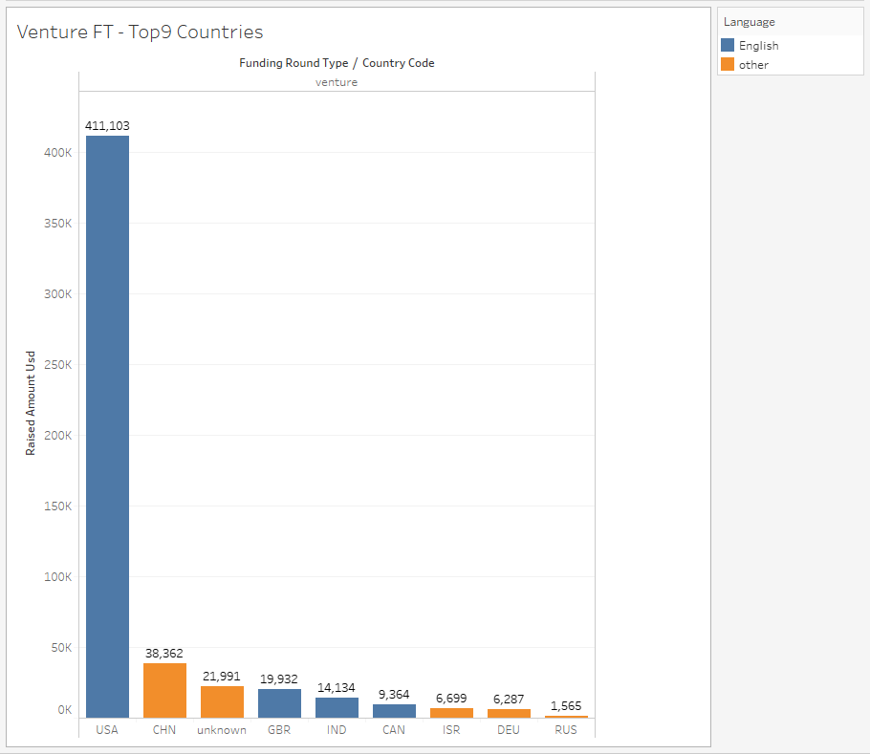

Slide 9
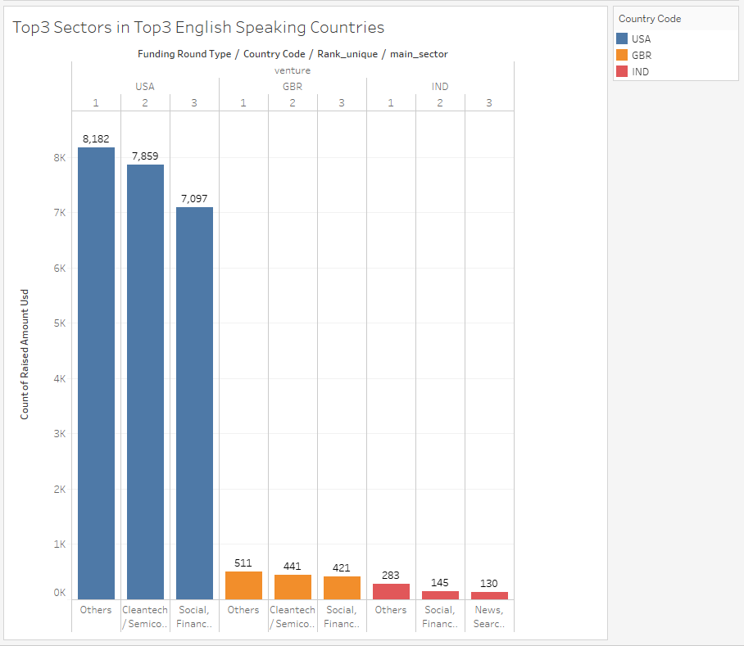

Slide 10
Recommendations
Best strategy for Spark Funds would be to invest in:
The United States of America in the cutting edge technology or Cleantech / Semiconductors space
Great Britain in the cutting edge technology or Cleantech / Semiconductors space
India in the cutting edge technology or Social media, analytics and finance space.

